Slide 1



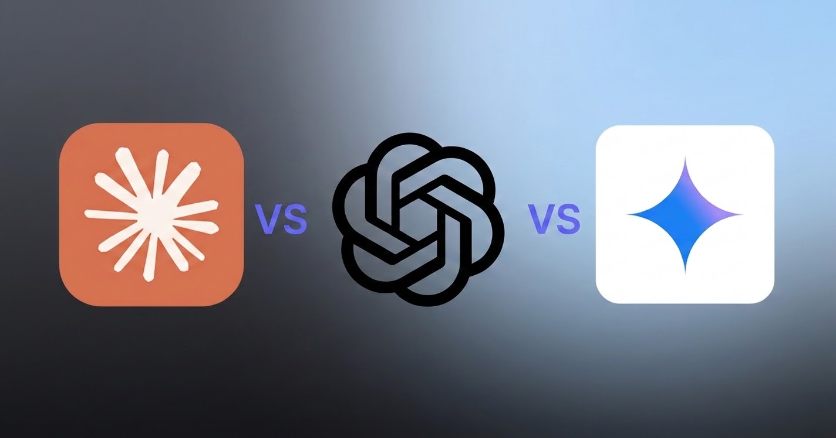
Beyond the Syntax: Mastering Agentic Coding
The Future of Software Engineering
Awwal Badru
PhD Candidate & MS, CS (United States) | M.Sc CS (Australia)
| B.Ed CS/Maths (Nigeria)
Research Areas:
Empirical Software Engineering
Software Security
Software Engineering Education
Computer Science Education

Slide 2
Workshop Outline
DAY 1: Foundations & Demo
•The Evolution of AI & Coding
•Coding Agents & Agentic Loop
•Demo: Context, Action & Verification
•IDE Setup and Resources
•Interactive Q & A

Slide 3
Workshop Outline
DAY 1: Foundations & Demo
•The Evolution of AI & Coding
•Coding Agents & Agentic Loop
•Demo: Context, Action & Verification
•IDE Setup and Resources
•Interactive Q & A
DAY 2: Practical Application
•Software Development Life Cycle
•Hands-on Building with Agents
•Git Versioning & Collaboration

Slide 4

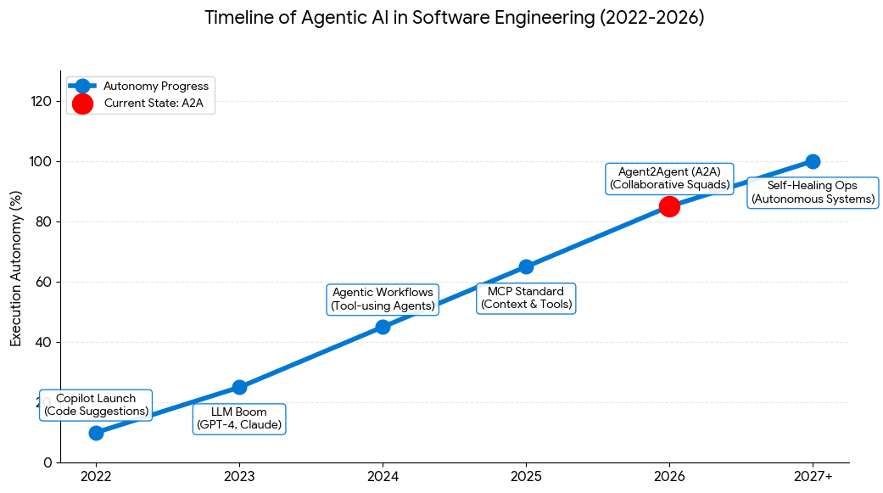
The Evolution of AI & Coding
Beyond the Syntax: Mastering Agentic Coding led by Awwal Badru

Slide 5
The Evolution of AI & Coding
Beyond the Syntax: Mastering Agentic Coding led by Awwal Badru

Slide 6
The Evolution of AI & Coding
Beyond the Syntax: Mastering Agentic Coding led by Awwal Badru

Slide 7
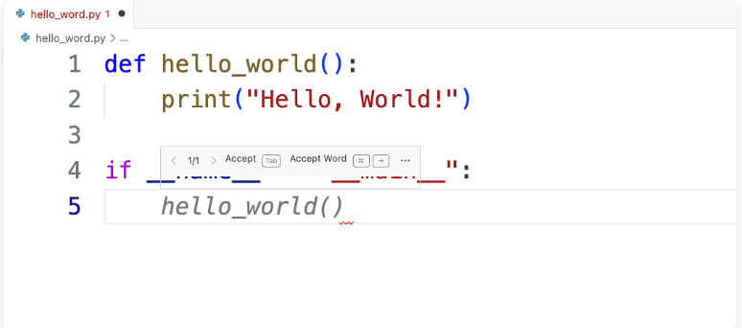
The Evolution of AI & Coding
1
Code Completion
Intelligent snippets and autocomplete based on context. Tools like traditional IDE intellisense.
Beyond the Syntax: Mastering Agentic Coding led by Awwal Badru

Slide 8
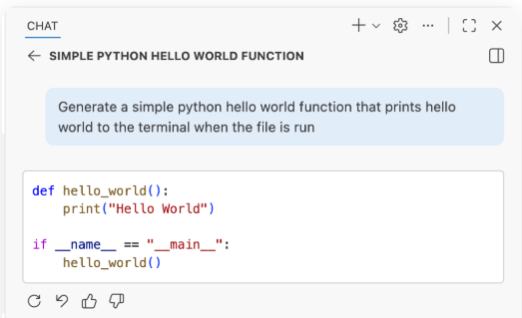
The Evolution of AI & Coding
2
Code Generation
Generative AI creating entire functions and boilerplate from natural language prompts. The era of Copilots.
Beyond the Syntax: Mastering Agentic Coding led by Awwal Badru

Slide 9
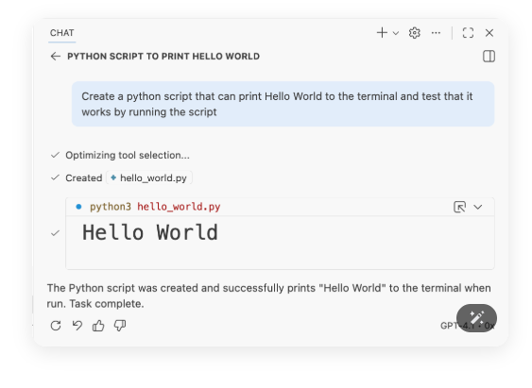
The Evolution of AI & Coding
3
Agentic Coding
Autonomous agents that reason, plan, and execute across files, using tools and verifying results.
Beyond the Syntax: Mastering Agentic Coding led by Awwal Badru

Slide 10
Coding Agents
developer_modeIDE
Copilot in VS Code
Cursor
Windsurf
Antigravity
Beyond the Syntax: Mastering Agentic Coding led by Awwal Badru

Slide 11
Coding Agents
developer_modeIDE
Copilot in VS Code
Cursor
Windsurf
Antigravity
terminalCLI
Copilot CLI
Claude Code
Pi
Beyond the Syntax: Mastering Agentic Coding led by Awwal Badru

Slide 12
Coding Agents
developer_modeIDE
Copilot in VS Code
Cursor
Windsurf
Antigravity
terminalCLI
Copilot CLI
Claude Code
Pi
publicWeb
Copilot in GitHub.com
Codex
Jules
Beyond the Syntax: Mastering Agentic Coding led by Awwal Badru

Slide 13
Coding Agents
developer_modeIDE
Copilot in VS Code
Cursor
Windsurf
Antigravity
terminalCLI
Copilot CLI
Claude Code
Pi
publicWeb
Copilot in GitHub.com
Codex
Jules
buildCustom
Copilot SDK
PyDantic AI
LangChain
Beyond the Syntax: Mastering Agentic Coding led by Awwal Badru

Slide 14
Coding Agents & Agentic Loop
What is an AI Agent?
An AI Agent is an LLM that calls tools in a loop to achieve a goal.
Source: https://simonwillison.net/2025/Sep/18/agents/?utm_source=chatgpt.com
Beyond the Syntax: Mastering Agentic Coding led by Awwal Badru

Slide 15

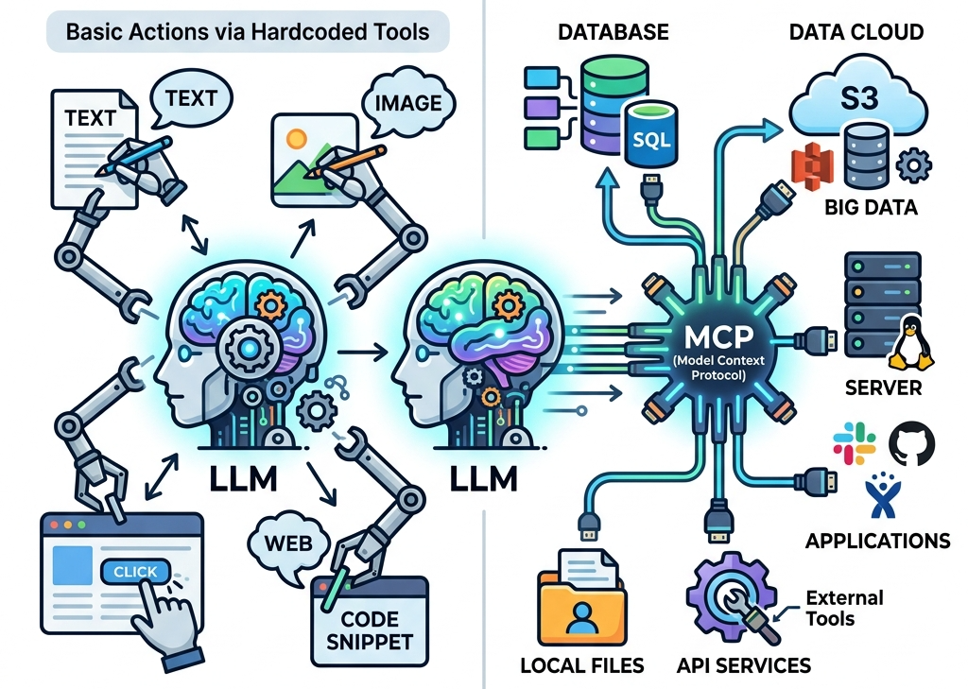
Coding Agents & Agentic Loop
What is an AI Agent?
An AI Agent is an LLM that calls tools in a loop to achieve a goal.
Beyond the Syntax: Mastering Agentic Coding led by Awwal Badru

Slide 16
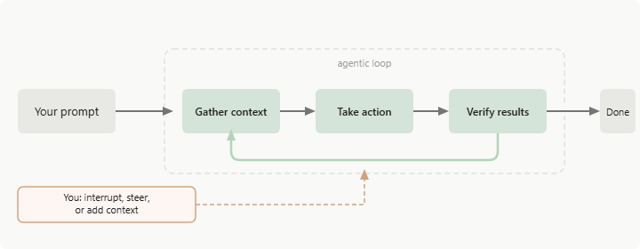
Coding Agents & Agentic Loop
What is an AI Agent?
An AI Agent is an LLM that calls tools in a loop to achieve a goal.
Source: https://code.claude.com/docs/en/how-claude-code-works
Beyond the Syntax: Mastering Agentic Coding led by Awwal Badru

Slide 17
Quick Pricing Overview (April 2026)
Service
Individual Plan
High-Usage/Max
Team/Business
GitHub Copilot
$10 /mo
$39 /mo (Pro+)
$19 /user/mo
Claude
$20 /mo
$100 - $200 /mo
$25 /user/mo
Antigravity
$29 /mo
$99 - $250 /mo
Custom
OpenAI Codex
$20 /mo (via ChatGPT Plus)
$200 /mo (Pro)
$25 /user/mo
Beyond the Syntax: Mastering Agentic Coding led by Awwal Badru

Slide 18
Demonstration
developer_modeIDE
terminalCLI
Beyond the Syntax: Mastering Agentic Coding led by Awwal Badru

Slide 19
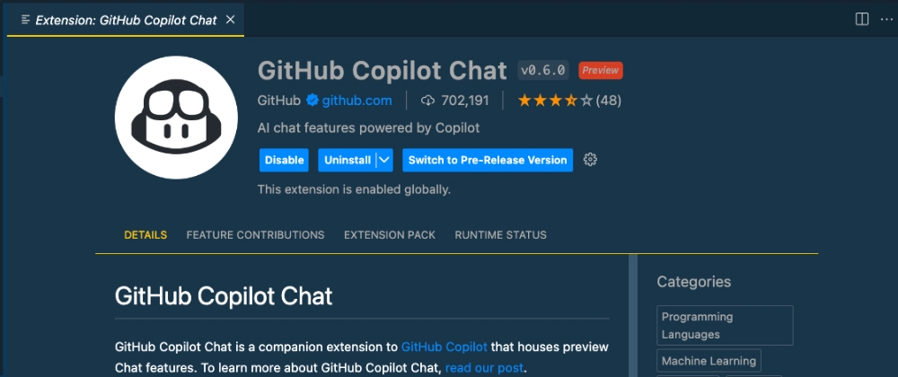
Demonstration
developer_modeIDE
terminalCLI
Beyond the Syntax: Mastering Agentic Coding led by Awwal Badru

Slide 20
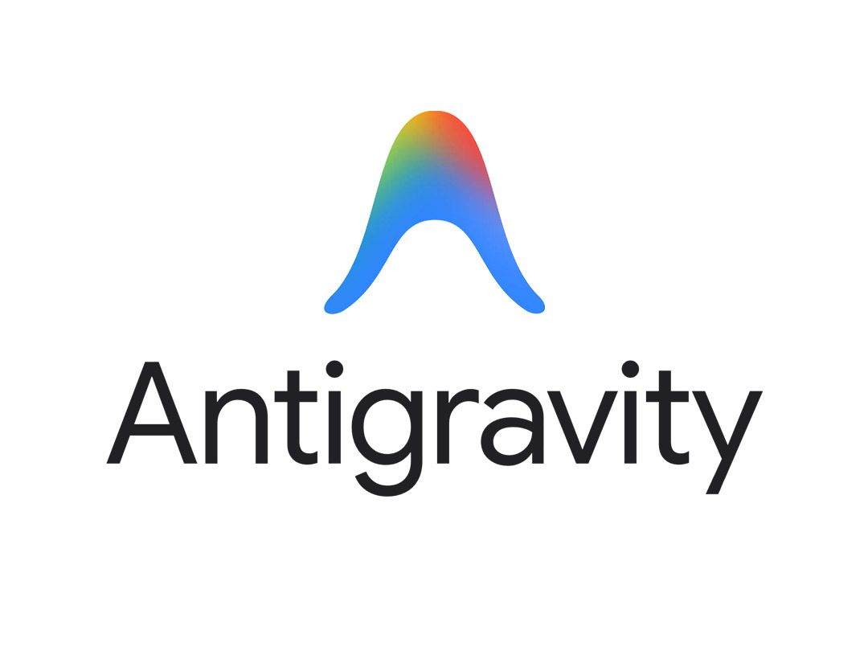
Demonstration
developer_modeIDE
terminalCLI
Beyond the Syntax: Mastering Agentic Coding led by Awwal Badru

Slide 21
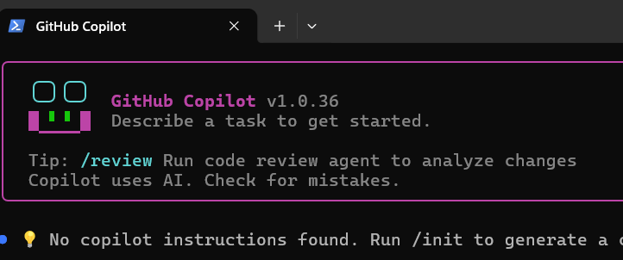
Demonstration
developer_modeIDE
terminalCLI
Beyond the Syntax: Mastering Agentic Coding led by Awwal Badru

Slide 22
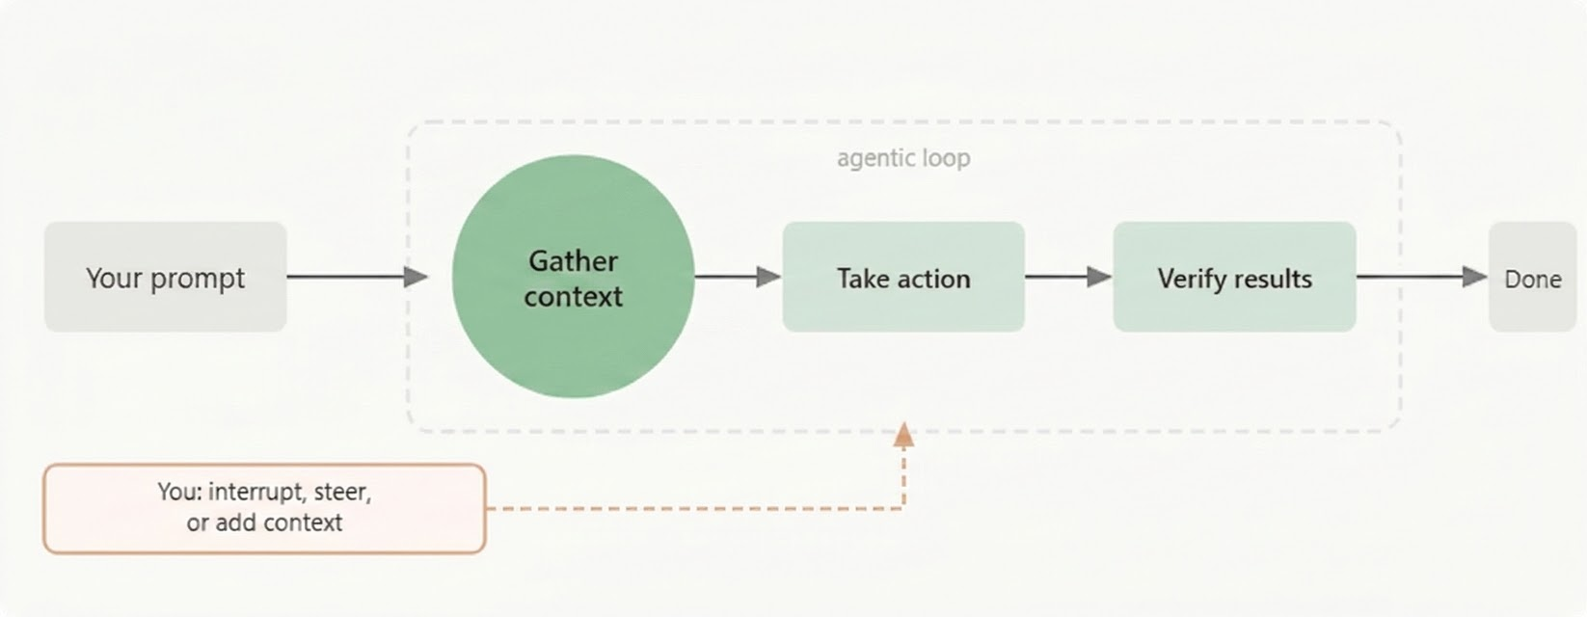
Equipping Agents with Context
Including Files and Assets
Directly provide files, images, and GitHub items (Issues, PRs)
Offer exemplar files containing best-practice code
Directive Documentation
copilot-instructions.md — GitHub Copilot
cursor rules — Specific to Cursor IDE
claude.md — Tailored for Claude Code
agents.md — The standard OpenAI format
Beyond the Syntax: Mastering Agentic Coding led by Awwal Badru

Slide 23
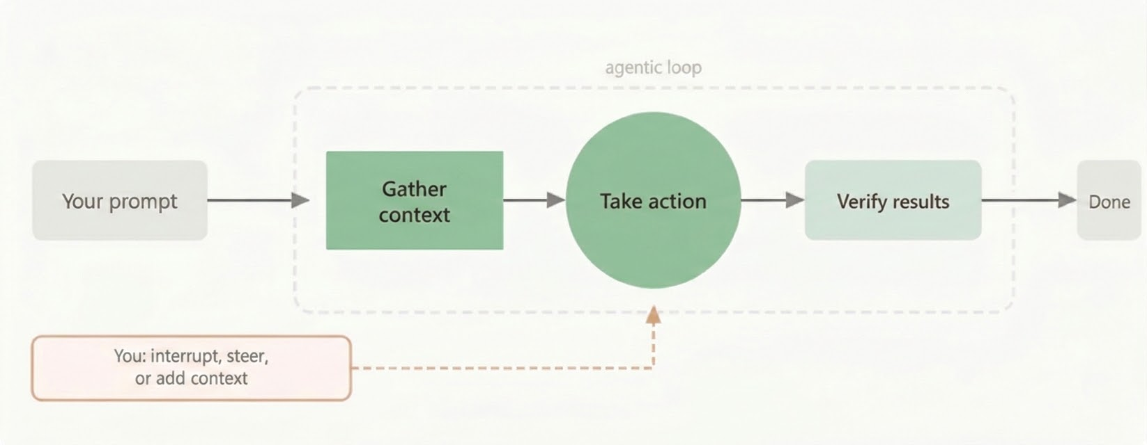
Providing Tools to an Agent
MCP — Model Context Protocol
Open protocol for giving agents access to tools
In IDE: search @mcp in extensions for vetted servers
Pro Tip: You can also create your own MCP servers
Agent Skills
A reusable workflow defined in a SKILL.MD file
Skills can include tools, MCP servers, scripts, and more!
Beyond the Syntax: Mastering Agentic Coding led by Awwal Badru

Slide 24
Resources
developer_modeIDE (VS Code)
VS Code Installation
https://code.visualstudio.com/download
Copilot Installation from VS Code extension
https://www.youtube.com/watch?v=ws6t0NBle9g
Launching Copilot for free (please you need to have a github account)
https://www.youtube.com/watch?v=X_Aet9ndh_Y
VS Code Installation
developer_modeIDE ( Antigravity)
Google Agent IDE Installation
https://antigravity.google/download
You need to have gmail account to sign in and start using the agent for free
Beyond the Syntax: Mastering Agentic Coding led by Awwal Badru

Slide 25
Resources
terminalCLI (Copilot)
Installation npm (requires Node.js 22+)
https://www.youtube.com/watch?v=BDxRhhs36ns
Installation on windows via (WinGet)
https://www.youtube.com/watch?v=3mCaZ_tYdI0
terminalCLI (Copilot)
Install commands:
Windows (WinGet): winget install GitHub.Copilot
npm (requires Node.js 22+): npm install -g @github/copilot
macOS / Linux: brew install copilot-cli
Beyond the Syntax: Mastering Agentic Coding led by Awwal Badru

Slide 26
Beyond the Syntax: Mastering Agentic Coding
The Future of Software Engineering
Awwal Badru
PhD Candidate & MS, CS (United States) | M.Sc CS (Australia)
| B.Ed CS/Maths (Nigeria)
Research Areas:
Empirical Software Engineering
Software Security
Software Engineering Education
Computer Science Education

Slide 27
Workshop Outline
DAY 1: Foundations & Demo
•The Evolution of AI & Coding
•Coding Agents & Agentic Loop
•Demo: Context, Action & Verification
•IDE Setup and Resources
•Interactive Q & A
DAY 2: Practical Application
•Software Development Life Cycle
•Hands-on Building with Agents
•Git Versioning & Collaboration

Slide 28
SDLC
The 7 Phases of SDLC
1. Planning
Define scope, costs, and identify risks.
Beyond the Syntax: Mastering Agentic Coding led by Awwal Badru

Slide 29
SDLC
The 7 Phases of SDLC
1. Planning
Define scope, costs, and identify risks.
2. Requirements
Gather needs from stakeholders (the "what").
Beyond the Syntax: Mastering Agentic Coding led by Awwal Badru

Slide 30
SDLC
The 7 Phases of SDLC
1. Planning
Define scope, costs, and identify risks.
2. Requirements
Gather needs from stakeholders (the "what").
3. Design
Architecture, UI/UX, and data models.
Beyond the Syntax: Mastering Agentic Coding led by Awwal Badru

Slide 31
SDLC
The 7 Phases of SDLC
1. Planning
Define scope, costs, and identify risks.
2. Requirements
Gather needs from stakeholders (the "what").
3. Design
Architecture, UI/UX, and data models.
4. Implementation
The actual writing of the source code.
Beyond the Syntax: Mastering Agentic Coding led by Awwal Badru

Slide 32
SDLC
The 7 Phases of SDLC
1. Planning
Define scope, costs, and identify risks.
2. Requirements
Gather needs from stakeholders (the "what").
3. Design
Architecture, UI/UX, and data models.
4. Implementation
The actual writing of the source code.
5. Testing
Verify software for bugs and requirements.
Beyond the Syntax: Mastering Agentic Coding led by Awwal Badru

Slide 33
SDLC
The 7 Phases of SDLC
1. Planning
Define scope, costs, and identify risks.
2. Requirements
Gather needs from stakeholders (the "what").
3. Design
Architecture, UI/UX, and data models.
4. Implementation
The actual writing of the source code.
5. Testing
Verify software for bugs and requirements.
6. Deployment
Release to production environment.
Beyond the Syntax: Mastering Agentic Coding led by Awwal Badru

Slide 34
SDLC
The 7 Phases of SDLC
1. Planning
Define scope, costs, and identify risks.
2. Requirements
Gather needs from stakeholders (the "what").
3. Design
Architecture, UI/UX, and data models.
4. Implementation
The actual writing of the source code.
5. Testing
Verify software for bugs and requirements.
6. Deployment
Release to production environment.
7. Maintenance
Fix issues, update, and monitor.
Beyond the Syntax: Mastering Agentic Coding led by Awwal Badru

Slide 35
Hands-on Learning
For UX/UI
https://stitch.withgoogle.com/
Beyond the Syntax: Mastering Agentic Coding led by Awwal Badru

Slide 36
Hands-on Learning
What are app are you building?
1. Planning
Define scope, costs, and identify risks.
2. Requirements
Gather needs from stakeholders (the "what").
3. Design
Architecture, UI/UX, and data models.
4. Implementation
The actual writing of the source code.
5. Testing
Verify software for bugs and requirements.
Beyond the Syntax: Mastering Agentic Coding led by Awwal Badru

